Slide 1
Tracking Prescriptions Database
Laura Dampman

Slide 2
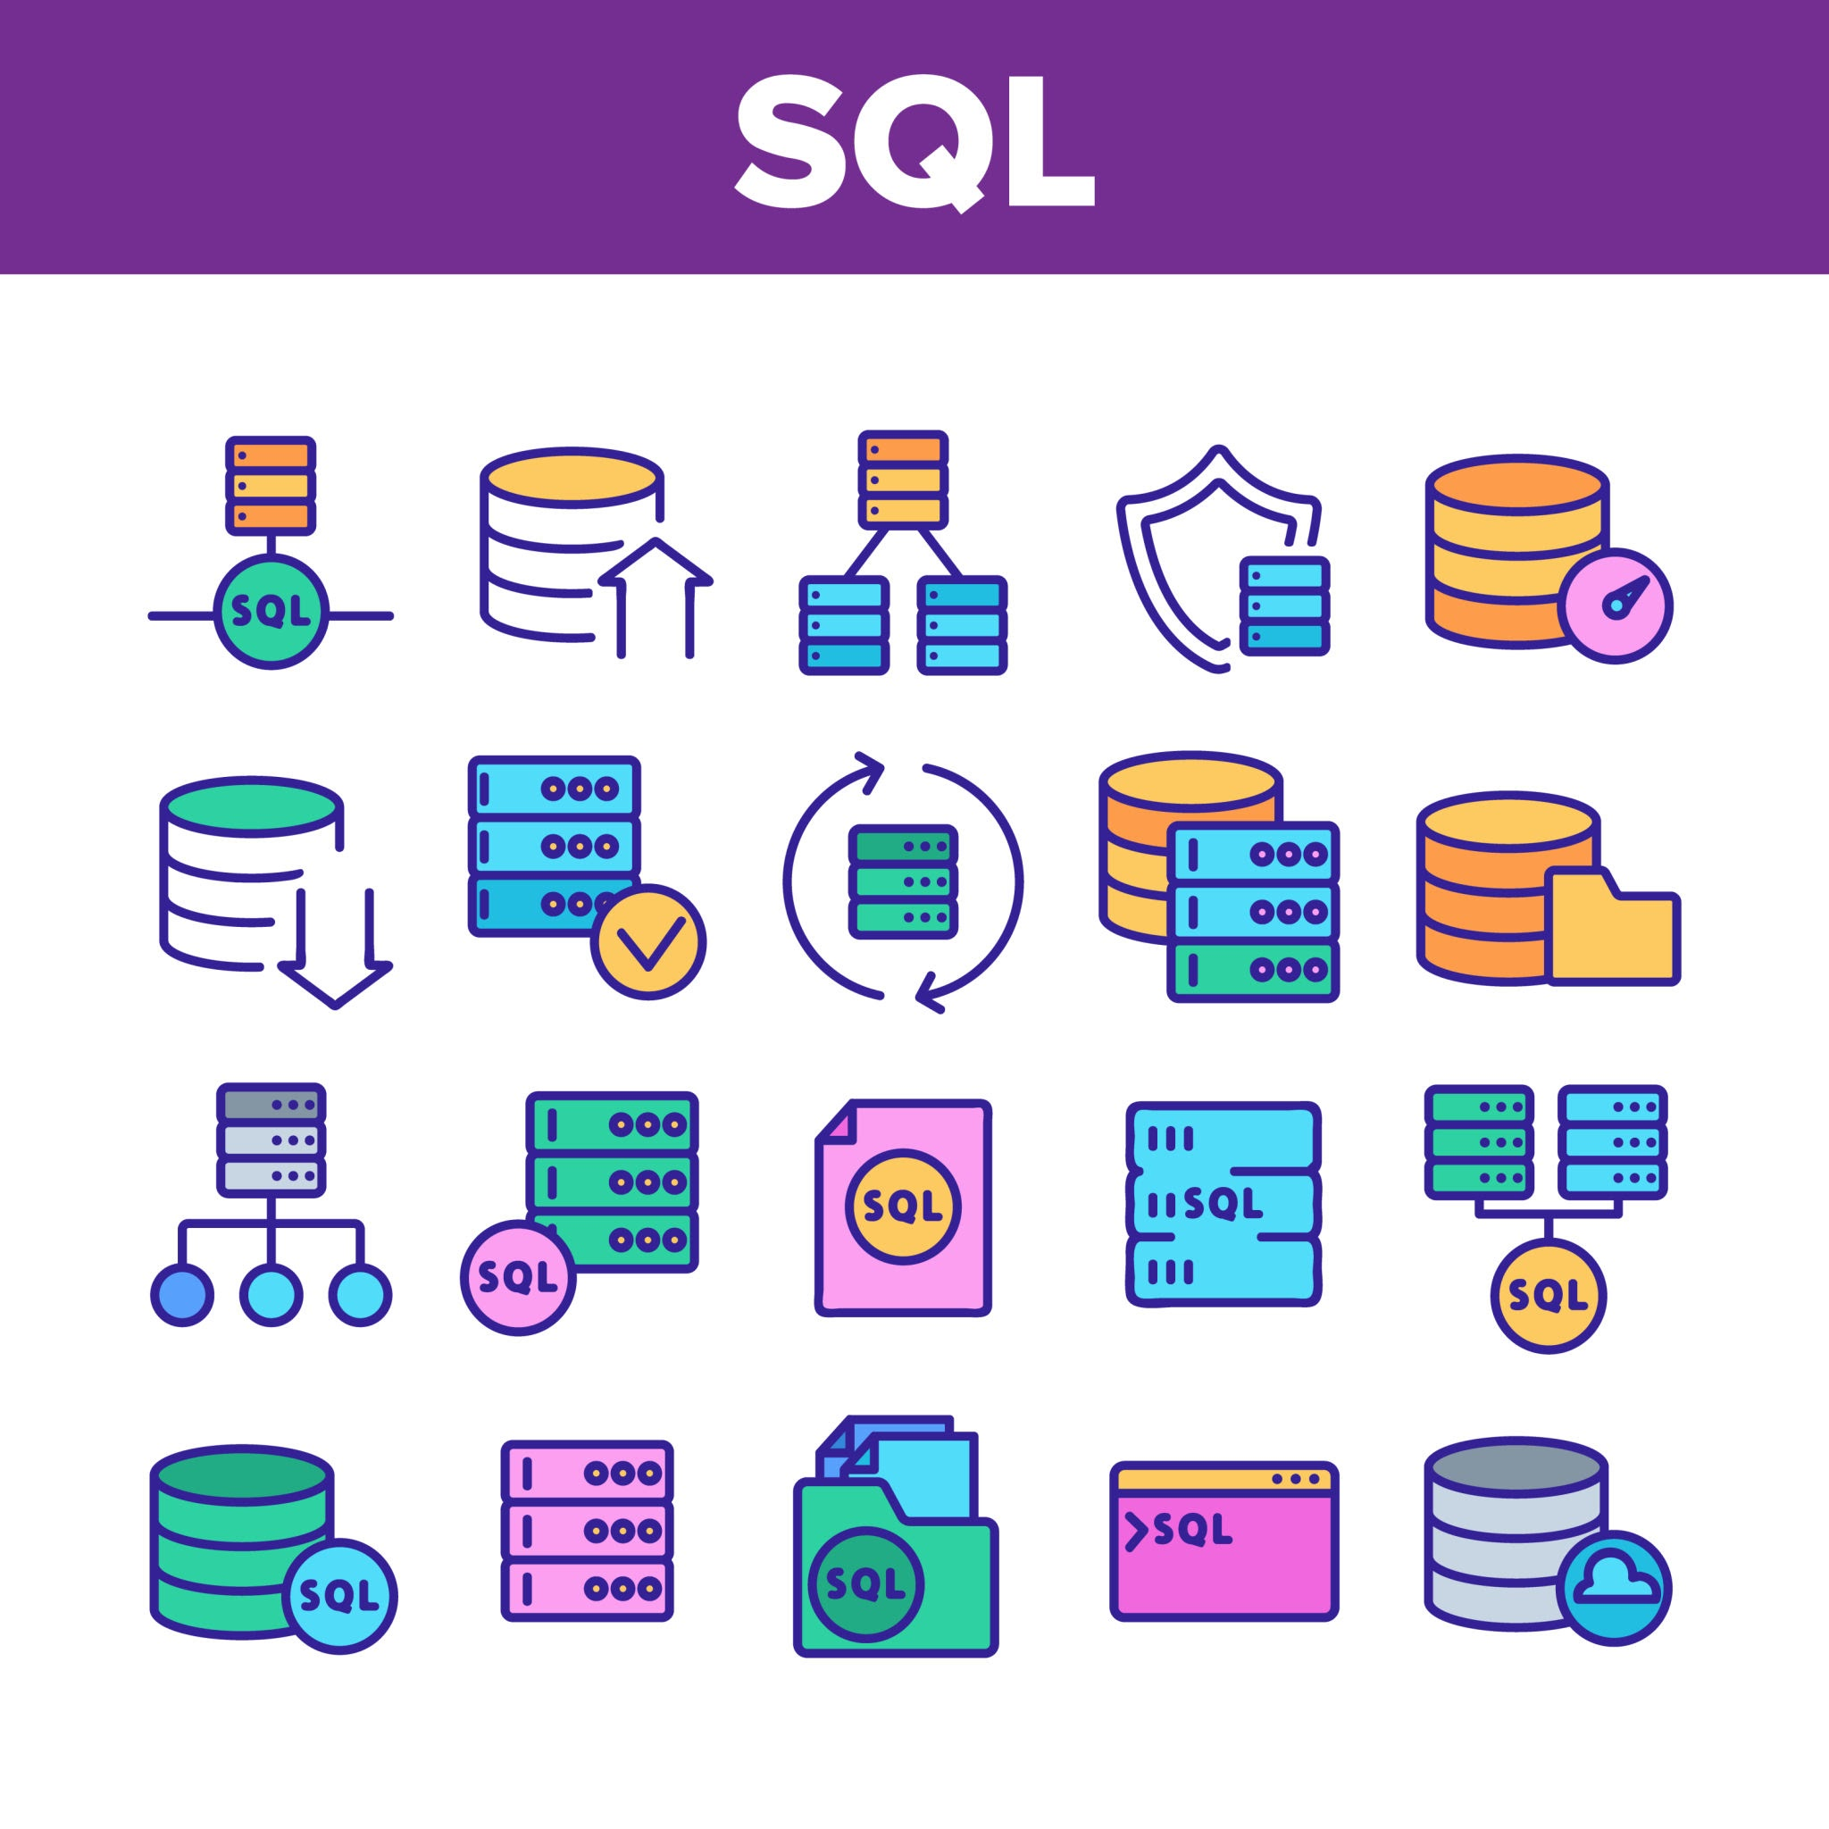
My Project
Original idea: building a prescription tracking mobile app.
Scaled down: Chose to design database
Future Goal: to use as foundation for future mobile app

Slide 3
Purpose For My Database
First Goal:
Prescription Tracking
From doctor to pharmacy to user:
Received, In Process, Complete
Second Goal:
The power of knowledge
As a customer understanding:
Cost - Insurance - Available Choices

Slide 4
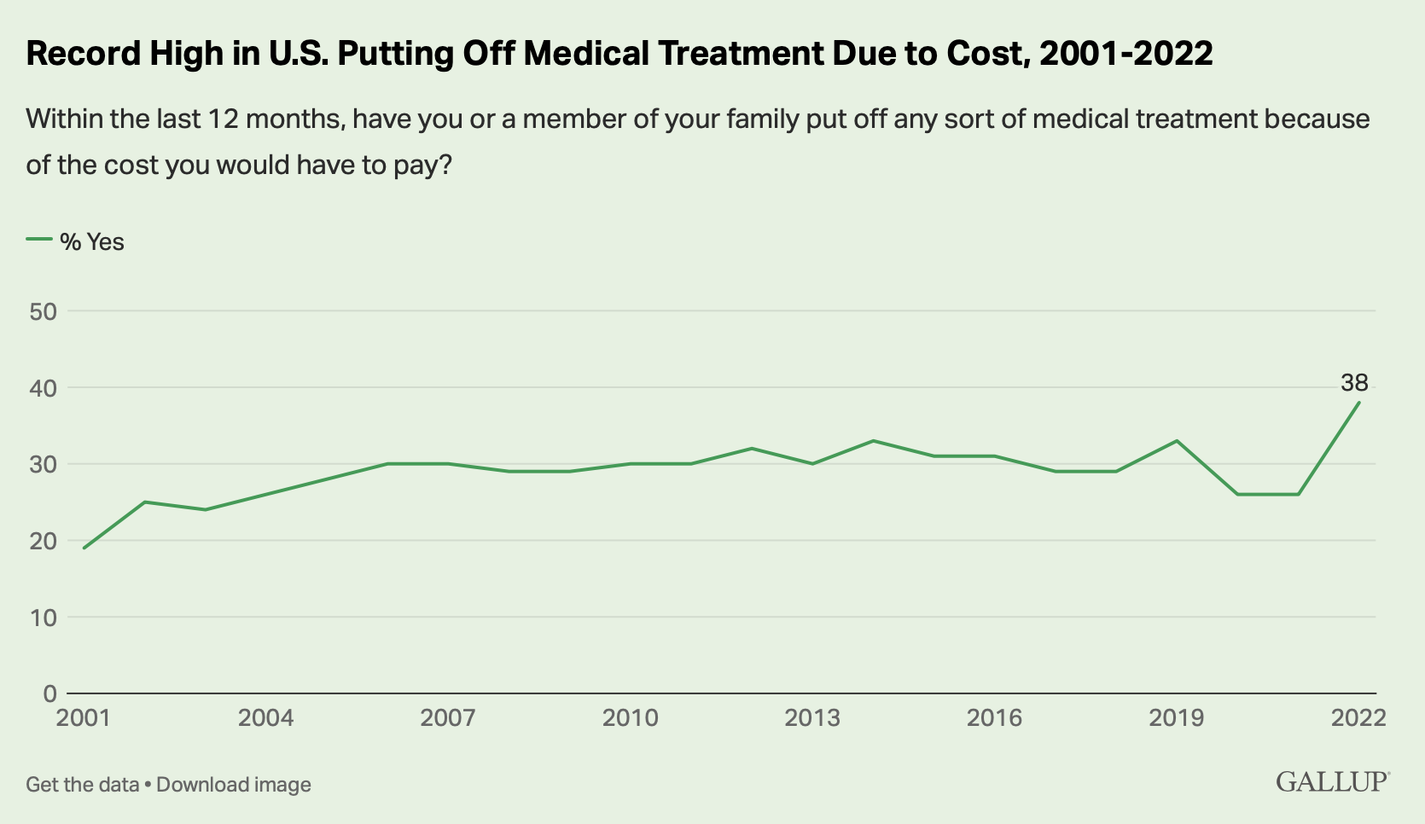
Why?
Issues with US healthcare
Prescription costs too high
Not understanding prescription options
% of people putting off medical treatment from 2001-2022 due to cost

Slide 5
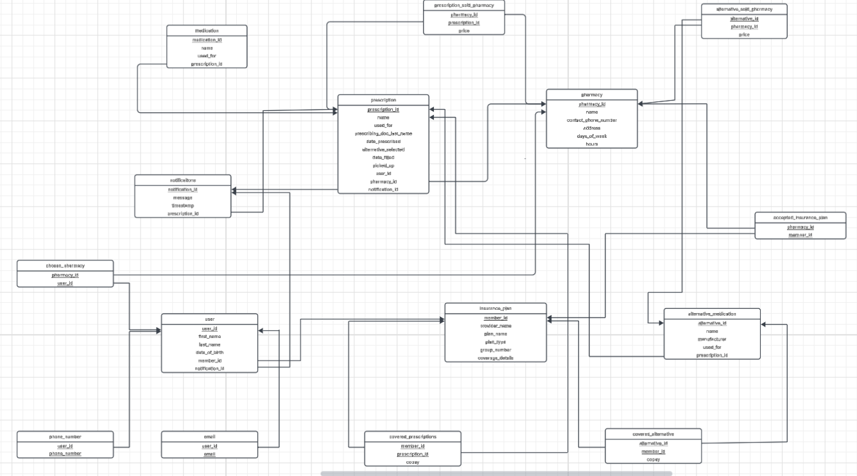
My Database

Slide 6
Tables
Pharmacy - pharmacy info
Insurance plan - insurance info
Accepted insurance - what pharmacies accept what insurance
Notifications
Users -
phone numbers
emails
Chosen pharmacy
Prescription
Medication
3
Holds 14 tables

Slide 7
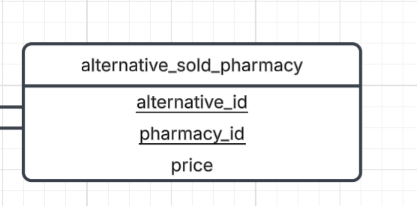
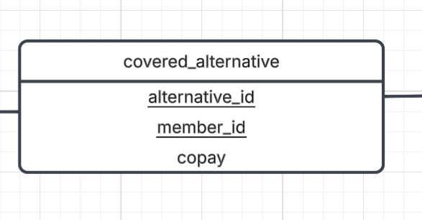
Creating tables for price checking:
Covered prescriptions with copay
Covered alternatives with copay
Non covered prescriptions with price
Non covered alternatives with price
Alternative medications tables: Relational Schema

Slide 8
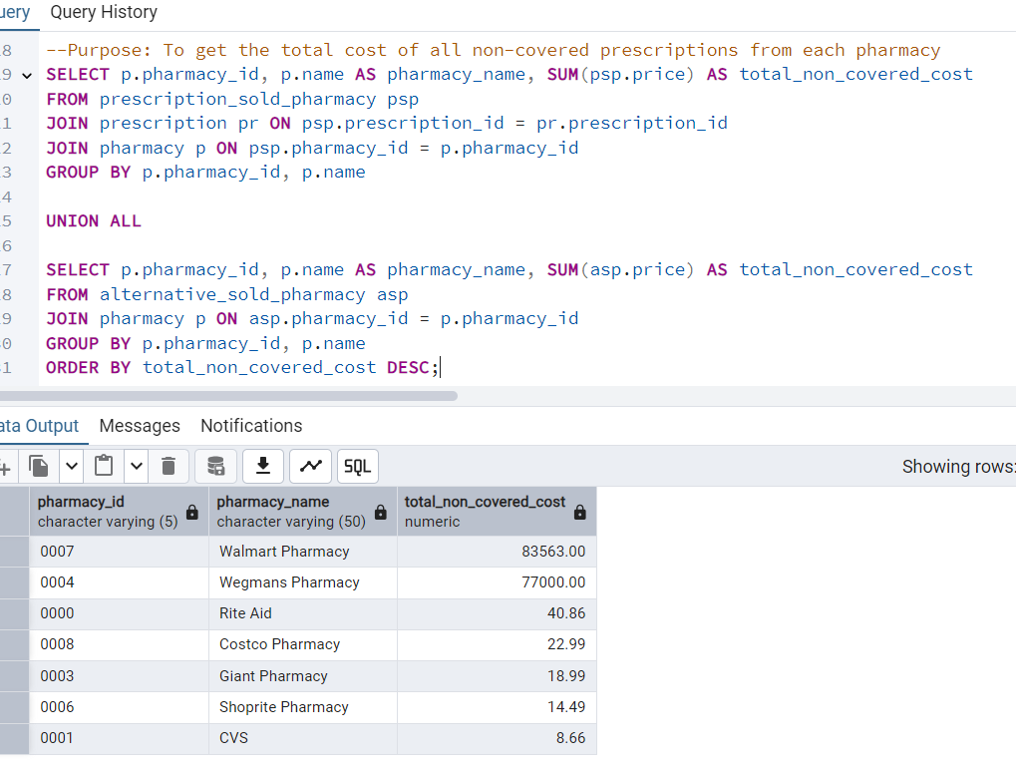
Queries

Slide 9
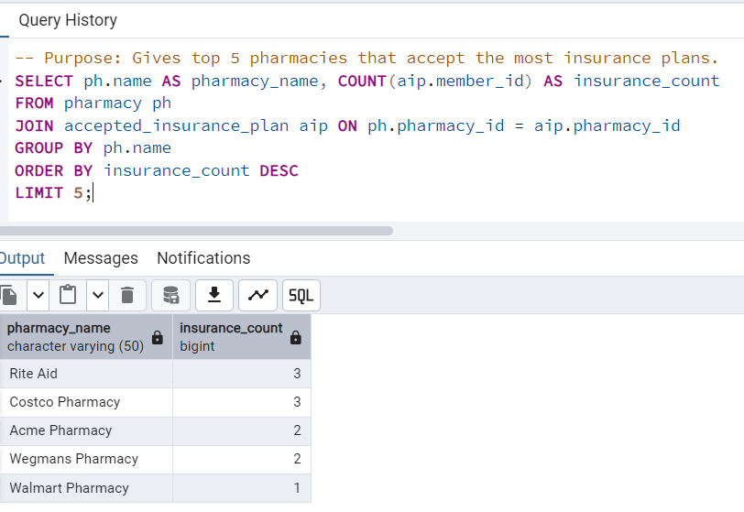
Query with results

Slide 10
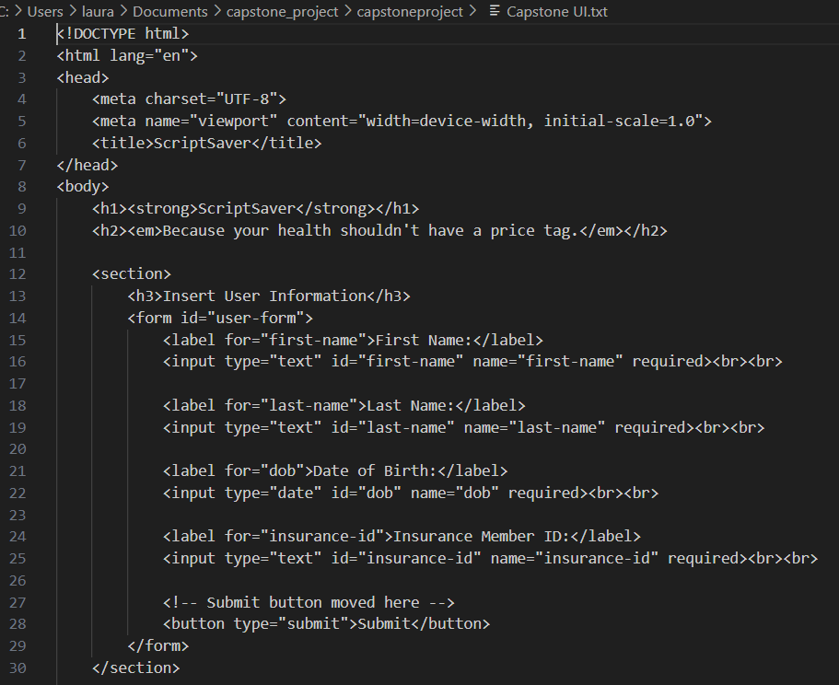
UI and Connecting
My user input code
User Interface:
User information: first name, last name, DOB and insurance member ID
Choosing a pharmacy from drop down menu
User interface should be user friendly and efficient

Slide 11
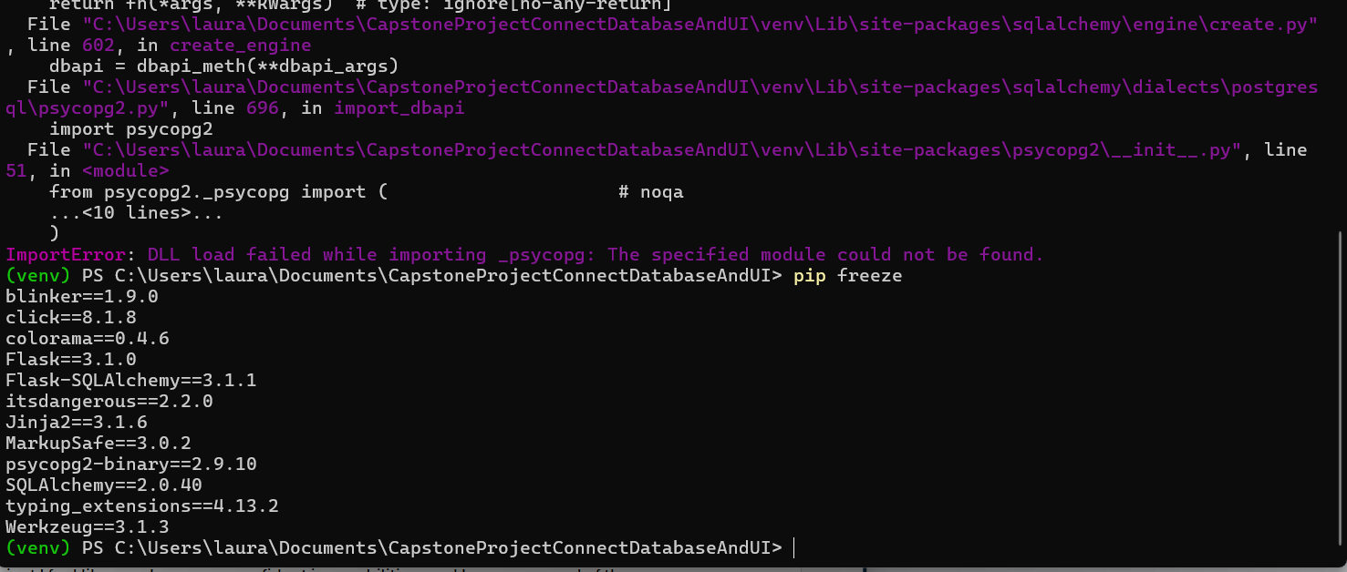
Connecting UI and Database
Challenging area for me
Chose to use virtual environment:
Keeps projects contained
Eliminates conflicts between packages
Flask:
Helps handles user requests from front end
Can define routes for better control
Works with packages like SQLAlchemy and psycopg2
Error message and psycopg2 installed

Slide 12
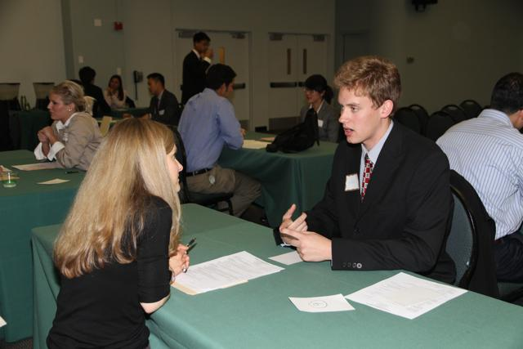
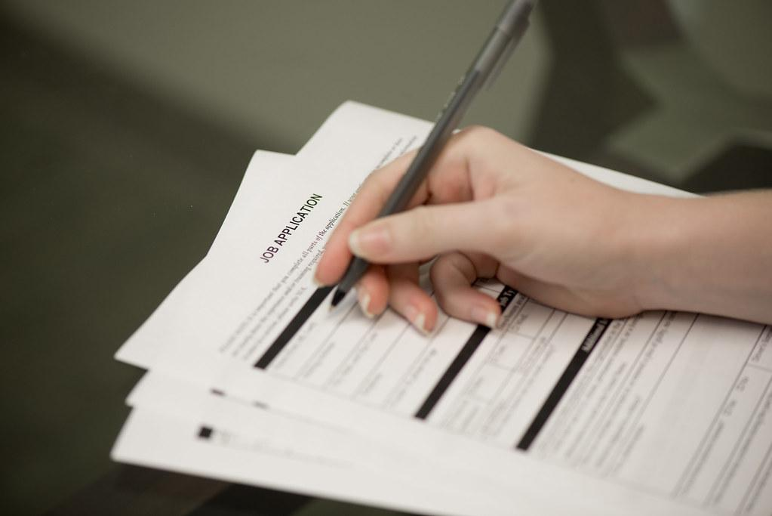
What I Gained From This Project
Given me valuable skills
Boosted self my confidence
Meeting future employers expectations
Taking my ideas and bringing them to life
Changing the lives of others
Excited to see what my future holds

